Slide 1
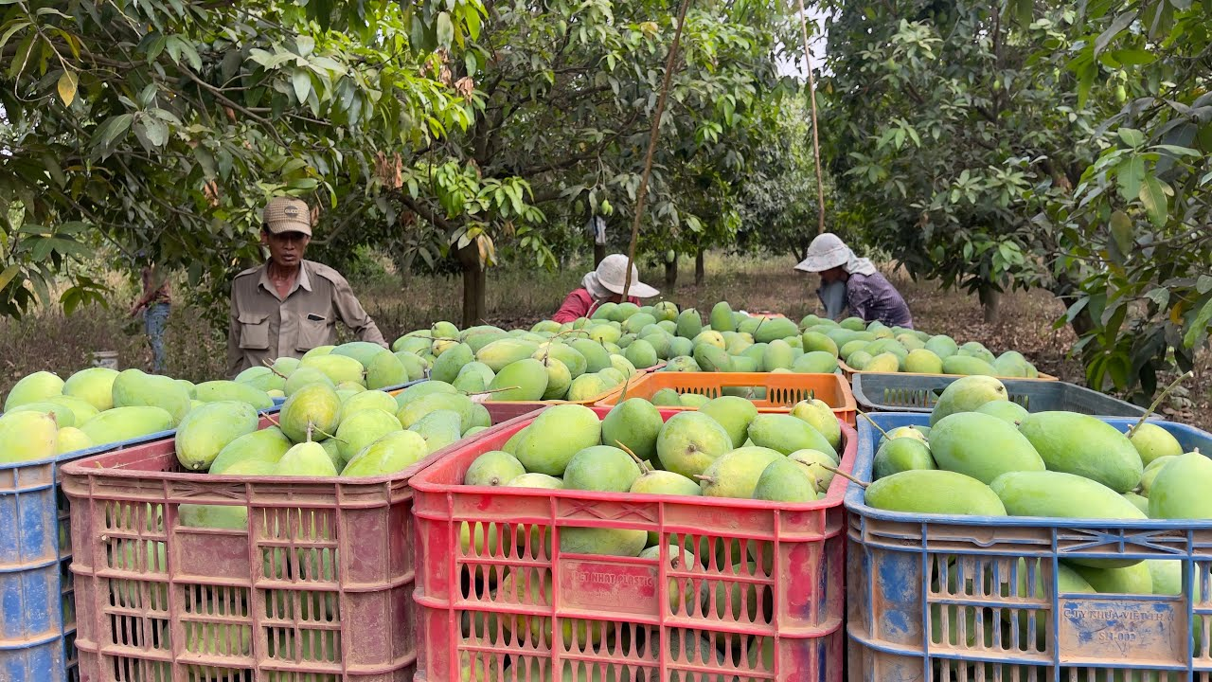
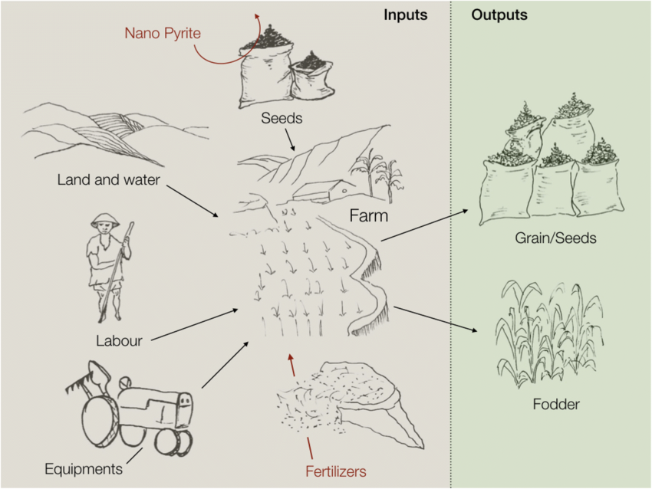
Farm Size and Yield Potential

Slide 2
From Small Orchards to Large Farms: How Much Can Be Produced?
Working assumptions
Based on the sources mentioned in the related Word document, we have established the following assumptions to estimate dried mango production:
Yield per hectare (fresh fruit):
- Low: 5 t/ha equivalent to 5,000 kg/ha
Medium: 7.5 t/ha equivalent to 7,500 kg/ha
High: 12 t/ha equivalent to 12,000 kg/ha

Slide 3
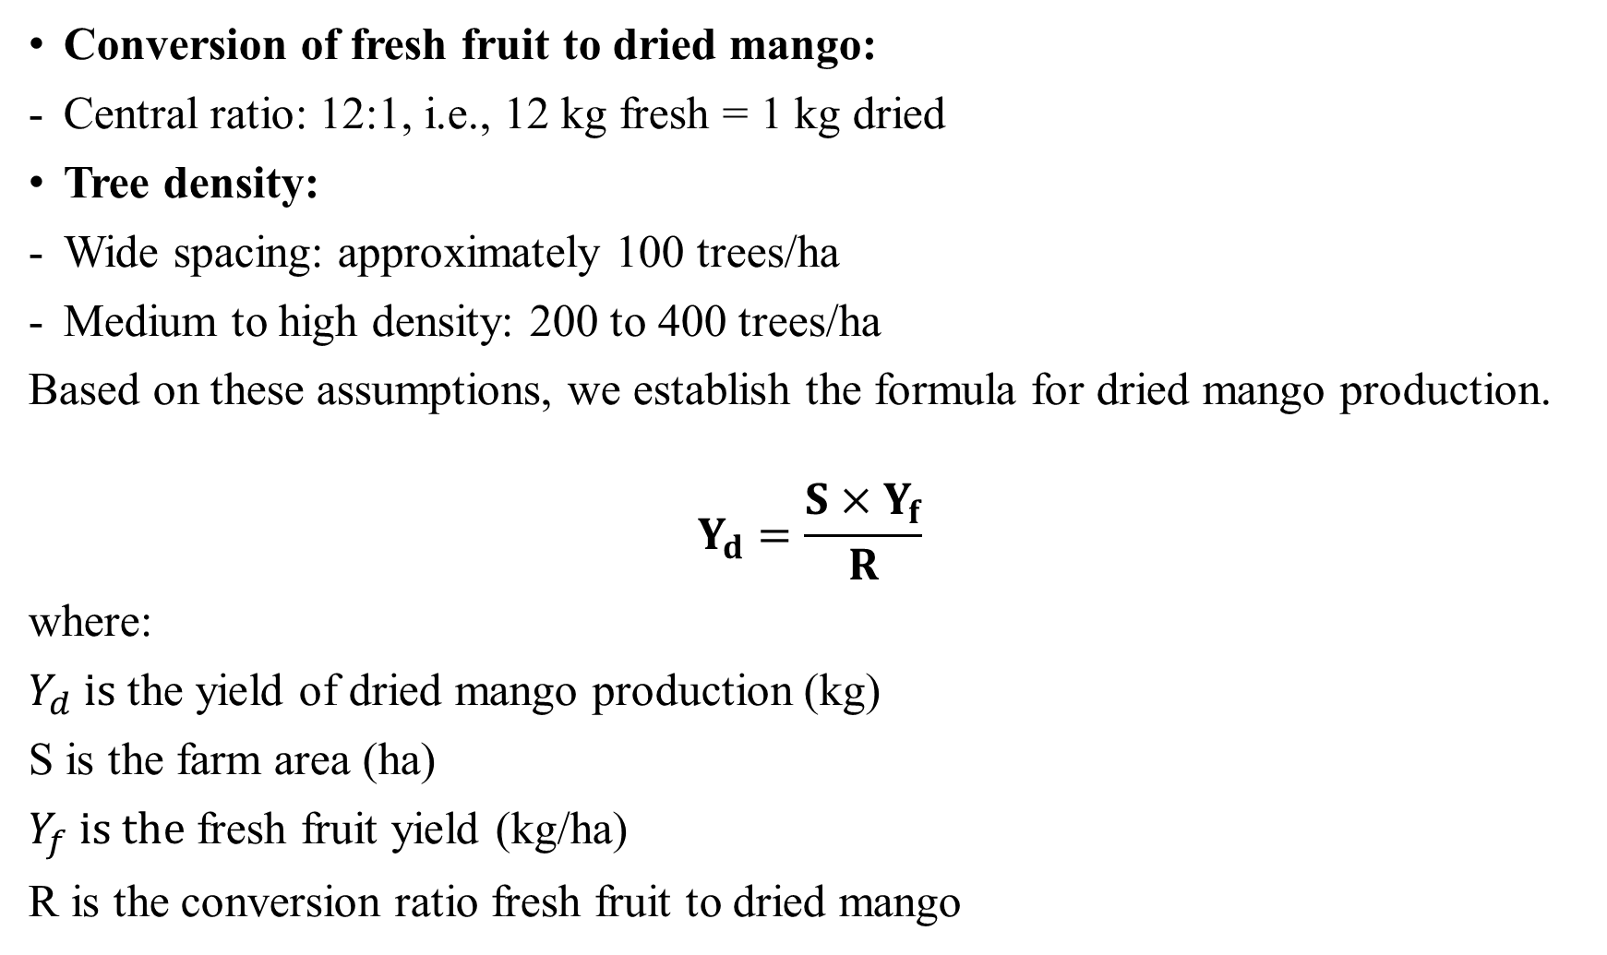
Conversion of fresh fruit to dried mango:
Central ratio: 12:1, i.e., 12 kg fresh = 1 kg dried
Tree density:
Wide spacing: approximately 100 trees/ha
Medium to high density: 200 to 400 trees/ha
Based on these assumptions, we establish the formula for dried mango production.
$$Y_{d}=\frac{S×Y_{f}}{R}$$
where:
$Y_{d} is$ the yield of dried mango production (kg)
S is the farm area (ha)
$Y_{f} is the$ fresh fruit yield (kg/ha)
R is the conversion ratio fresh fruit to dried mango

Slide 4
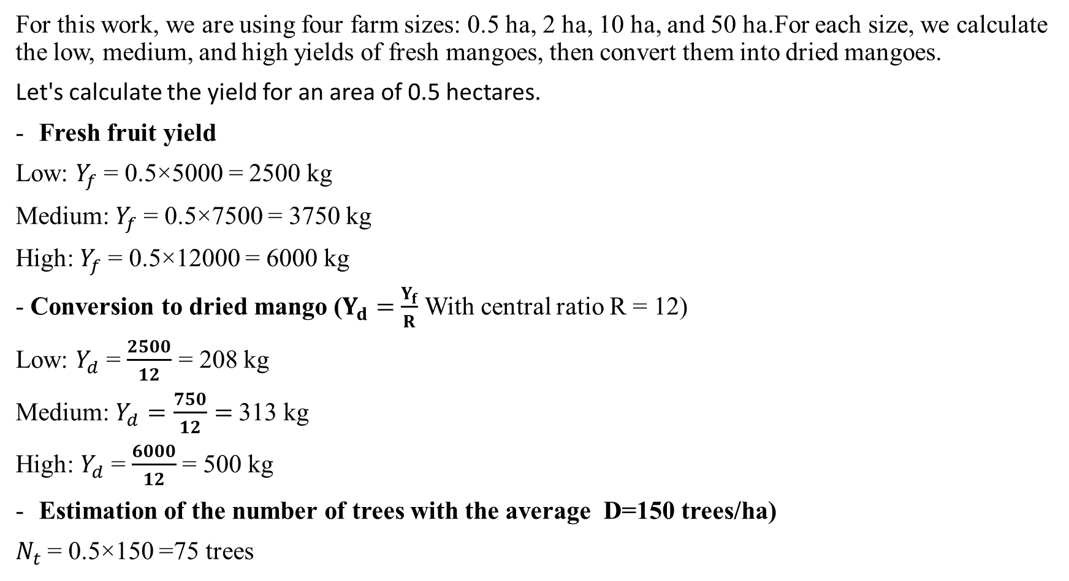
2. Estimated production based on farm size
For this work, we are using four farm sizes: 0.5 ha, 2 ha, 10 ha, and 50 ha.For each size, we calculate the low, medium, and high yields of fresh mangoes, then convert them into dried mangoes.
Let's calculate the yield for an area of 0.5 hectares.
Fresh fruit yield
Low: $Y_{f}$= 0.5×5000 = 2500 kg
Medium: $Y_{f}$= 0.5×7500 = 3750 kg
High: $Y_{f}$= 0.5×12000 = 6000 kg
- Conversion to dried mango ($Y_{d}=$ $\frac{Y_{f}}{R}$ With central ratio R = 12)
Low: $Y_{d}$= $\frac{2500}{12}$ = 208 kg
Medium: $Y_{d}=\frac{750}{12}=$313 kg
High: $Y_{d}$= $\frac{6000}{12}$= 500 kg
Estimation of the number of trees with the average D=150 trees/ha)
$N_{t}$= 0.5×150 =75 trees

Slide 5
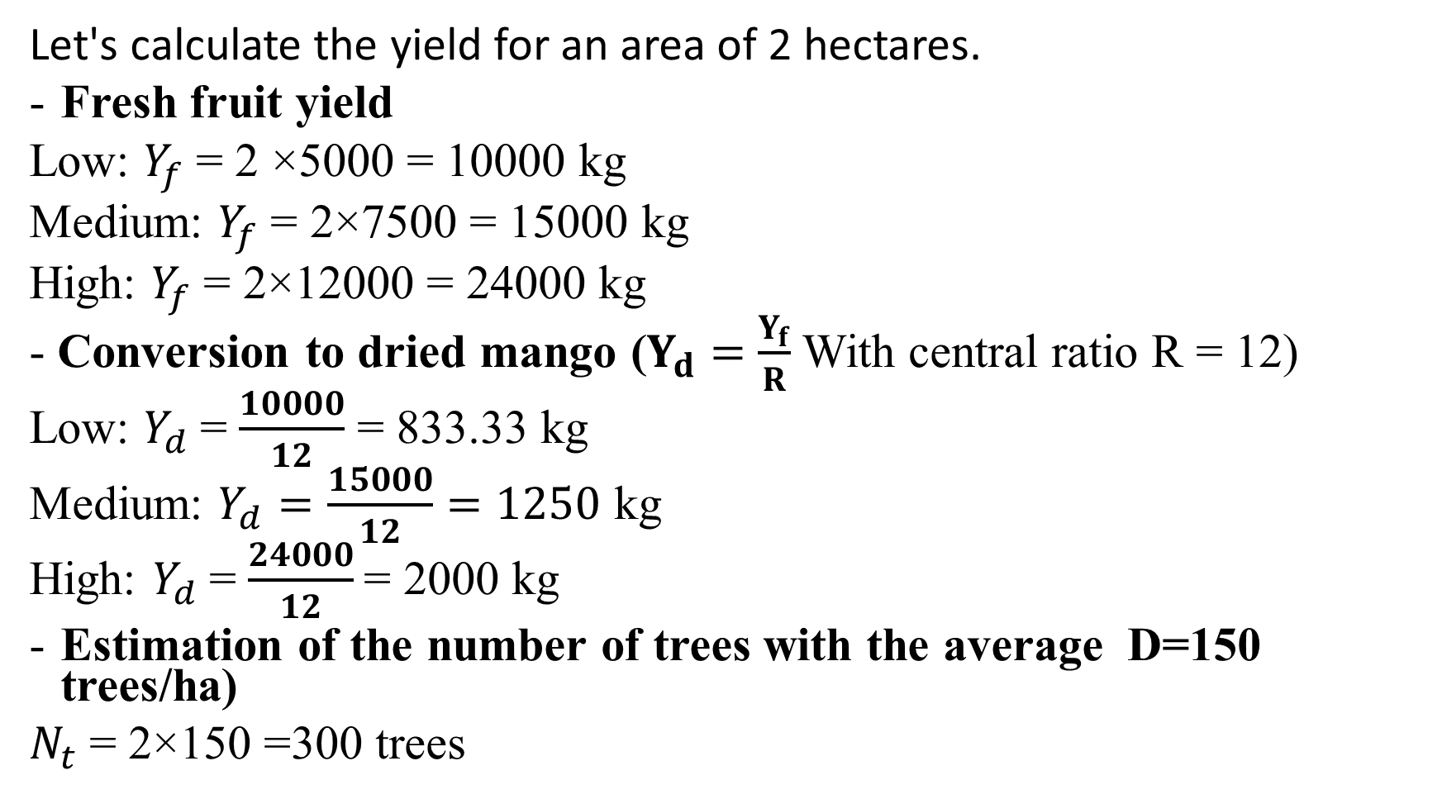
Let's calculate the yield for an area of 2 hectares.
Fresh fruit yield
Low: $Y_{f}$= 2 ×5000 = 10000 kg
Medium: $Y_{f}$= 2×7500 = 15000 kg
High: $Y_{f}$= 2×12000 = 24000 kg
- Conversion to dried mango ($Y_{d}=$ $\frac{Y_{f}}{R}$ With central ratio R = 12)
Low: $Y_{d}$= $\frac{10000}{12}$ = 833.33 kg
Medium: $Y_{d}=\frac{15000}{12}=1250$ kg
High: $Y_{d}$= $\frac{24000}{12}$= 2000 kg
Estimation of the number of trees with the average D=150 trees/ha)
$N_{t}$= 2×150 =300 trees

Slide 6
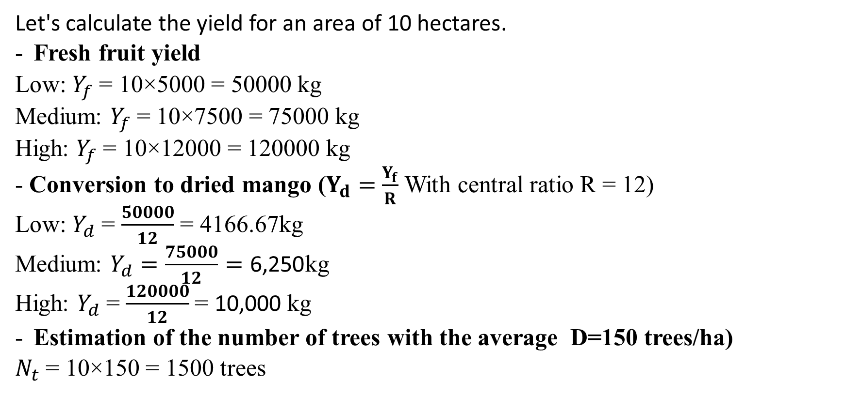
Let's calculate the yield for an area of 10 hectares.
Fresh fruit yield
Low: $Y_{f}$= 10×5000 = 50000 kg
Medium: $Y_{f}$= 10×7500 = 75000 kg
High: $Y_{f}$= 10×12000 = 120000 kg
- Conversion to dried mango ($Y_{d}=$ $\frac{Y_{f}}{R}$ With central ratio R = 12)
Low: $Y_{d}$= $\frac{50000}{12}$ = 4166.67kg
Medium: $Y_{d}=\frac{75000}{12}=\text{6,250}$kg
High: $Y_{d}$= $\frac{120000}{12}$= 10,000 kg
Estimation of the number of trees with the average D=150 trees/ha)
$N_{t}$= 10×150 = 1500 trees

Slide 7
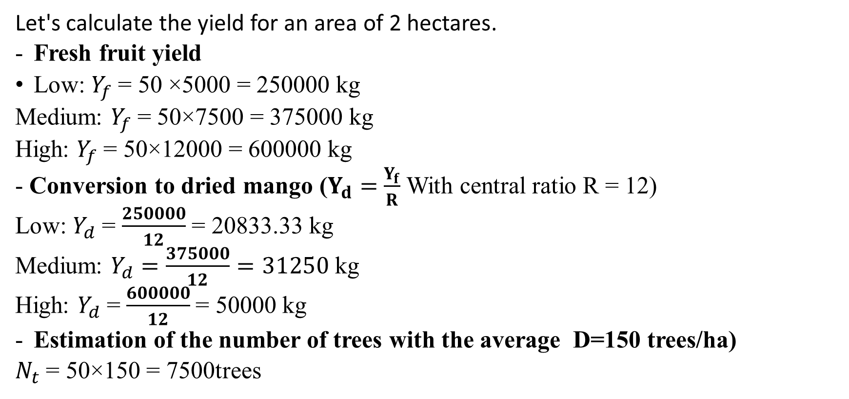
Let's calculate the yield for an area of 2 hectares.
Fresh fruit yield
Low: $Y_{f}$= 50 ×5000 = 250000 kg
Medium: $Y_{f}$= 50×7500 = 375000 kg
High: $Y_{f}$= 50×12000 = 600000 kg
- Conversion to dried mango ($Y_{d}=$ $\frac{Y_{f}}{R}$ With central ratio R = 12)
Low: $Y_{d}$= $\frac{250000}{12}$ = 20833.33 kg
Medium: $Y_{d}=\frac{375000}{12}=31250$ kg
High: $Y_{d}$= $\frac{600000}{12}$= 50000 kg
Estimation of the number of trees with the average D=150 trees/ha)
$N_{t}$= 50×150 = 7500trees

Slide 8
II. Data visualization

Slide 9
III. Results interpretation
Dried mango production grows linearly with cultivated area if yield per hectare remains constant.
A small farm (0.5 ha) is sufficient to test the local market, while a medium-sized farm (2 ha) produces 1 to 2 tons per year.
A commercial farm (10 ha) generates 4 to 10 tons annually.
An industrial farm (50 ha) produces 20 to 50 tons per years.

